Slide 1
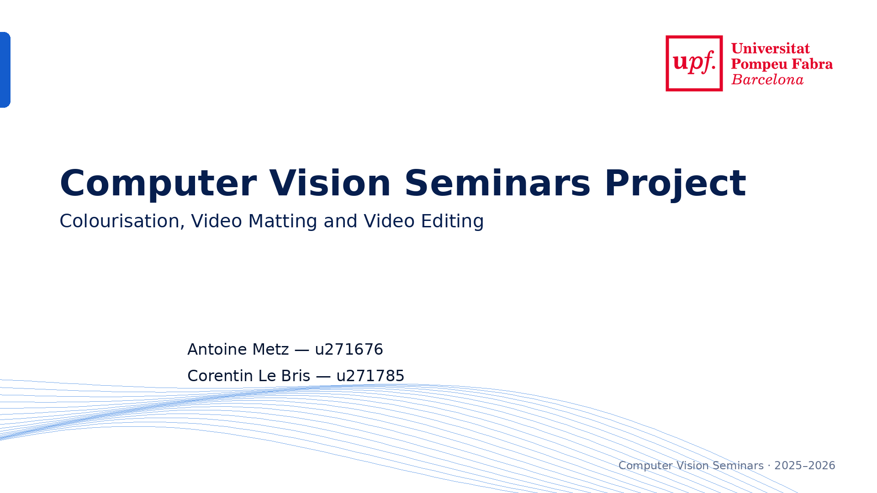
Notes:
Hello everyone. Today, we are going to present our Computer Vision seminars project

Slide 2


Notes:
Our project focuses on three topics: colourisation, video matting, and video editing. The goal was not only to create nice-looking videos. The main goal was to test different methods, apply them to the same inputs, and analyse their limits. We used three short videos, and for each topic we tested two methods. In total, we generated twenty-four output videos, including colourisation videos, matting alpha videos, composition videos, and editing videos. The main question was: how do image-based methods behave when we apply them to realistic short videos?

Slide 3
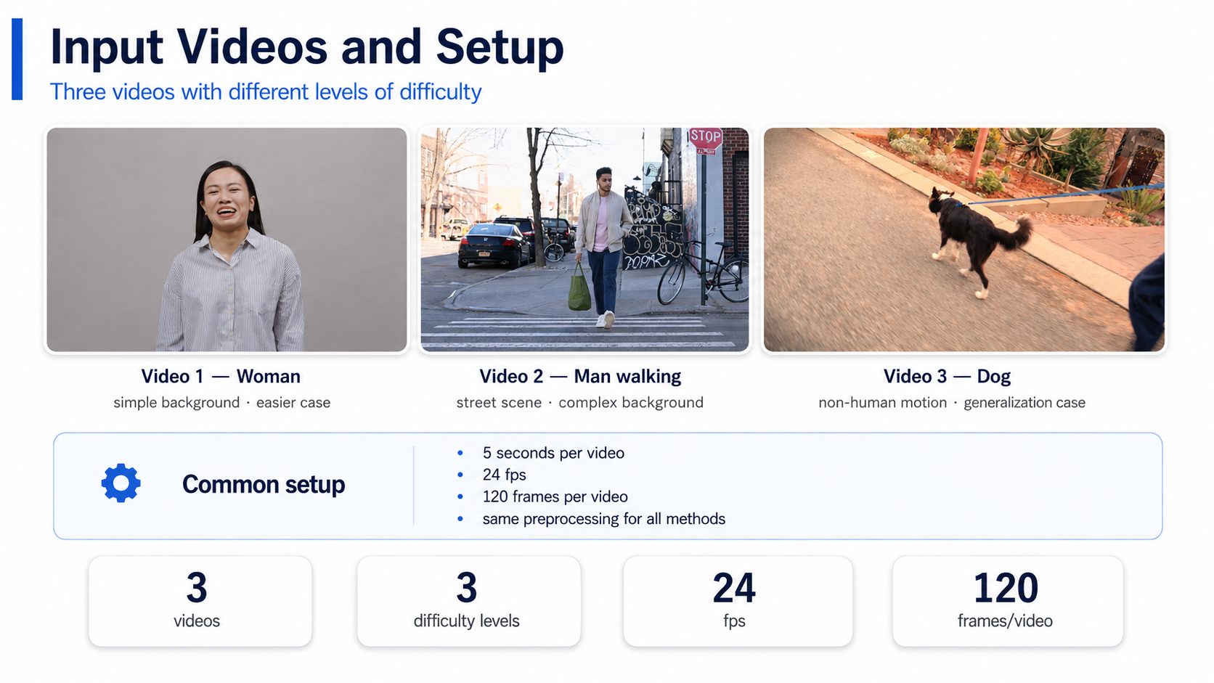

Notes:
We selected three videos with different levels of difficulty. The first video shows a woman with a simple background. This is the easiest case because the subject is clear and the background does not change much. The second video shows a man walking in the street. This case is more complex because there is motion, perspective, cars, buildings, and more visual details. The third video shows a dog moving outside. This is useful because it is not a human-centred video. It allows us to test if the methods can generalise to a non-human moving subject. All videos were processed in the same way: five seconds, twenty-four frames per second, and one hundred and twenty frames per video.

Slide 4
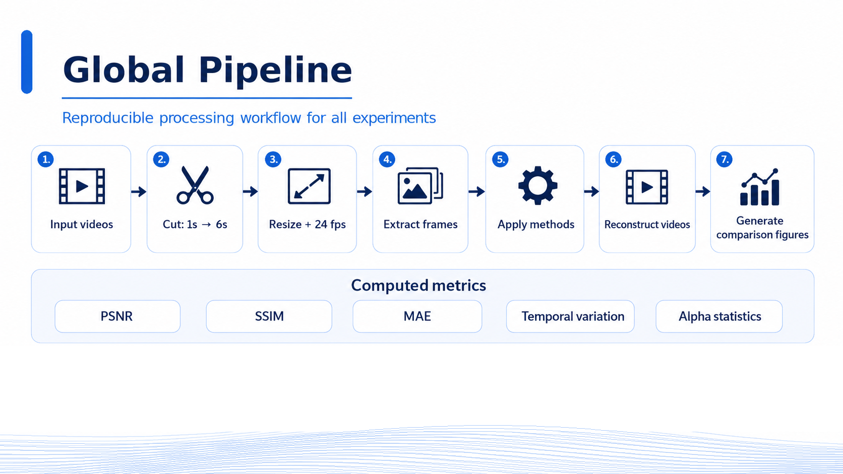
Notes:
Our pipeline was designed to make the experiments easier to compare. First, each input video was cut from second one to second six. Then, we resized the videos, converted them to twenty-four frames per second, and split them into individual frames. After that, we applied each method to the same three videos. When the processing was finished, the frames were reconstructed into output videos. We also generated comparison figures to analyse the results more easily. Finally, we computed simple metrics such as PSNR, SSIM, mean absolute error, temporal variation, and alpha statistics. The goal was to combine visual observations with some quantitative indicators.

Slide 5
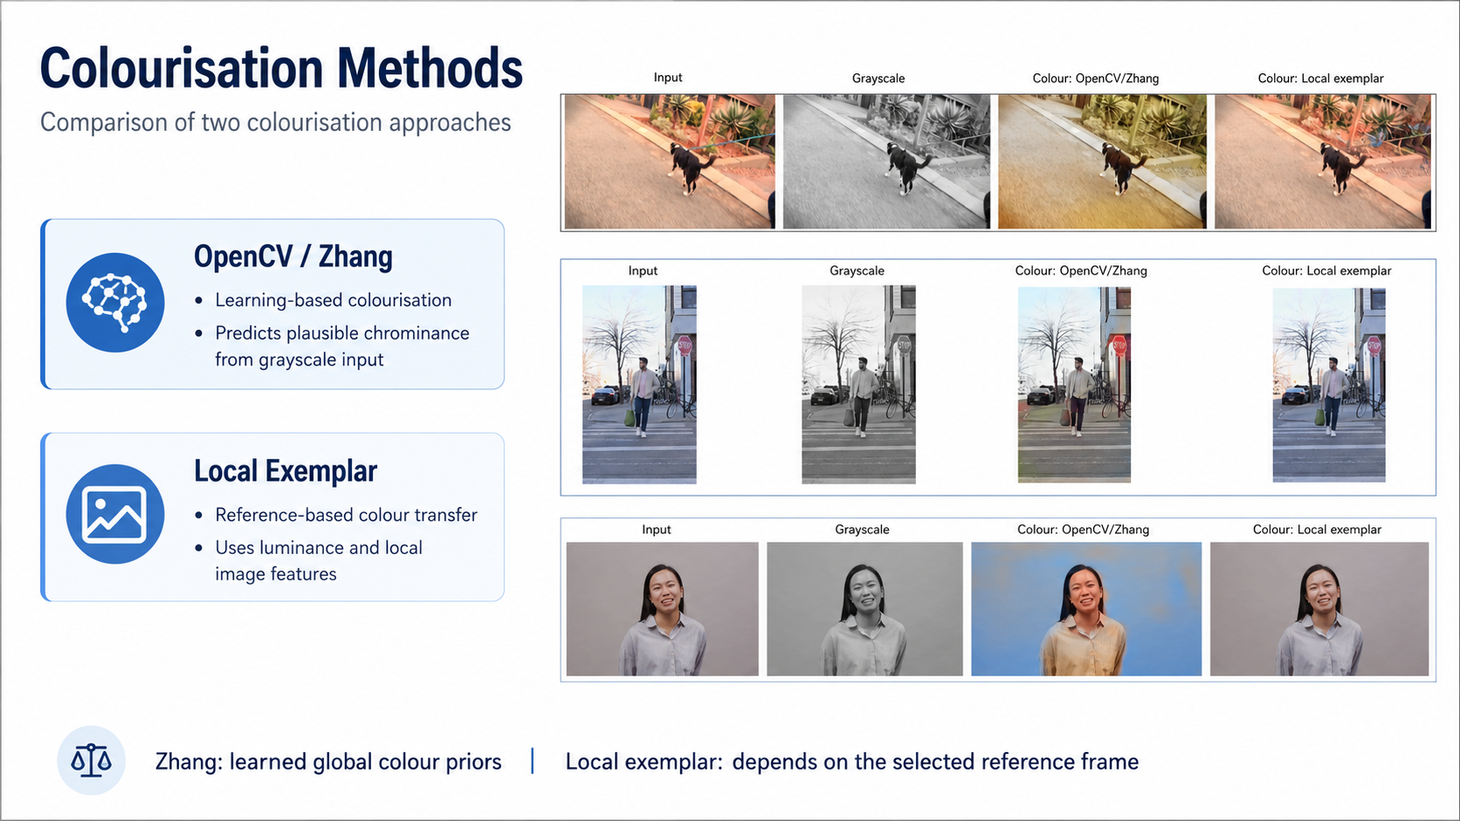
Notes:
For colourisation, we tested two approaches. The first one is the OpenCV implementation of the Zhang learning-based colourisation model. It takes grayscale frames as input and predicts plausible colours with a pretrained neural network. The second method is a local exemplar-based colour transfer method. Instead of learning general colours from a large dataset, it transfers colour information from a reference frame. The comparison is interesting because the two methods do not work in the same way. Zhang uses general colour priors learned from data, while the local exemplar method depends more on the chosen reference frame and on visual similarities inside the video.

Slide 6
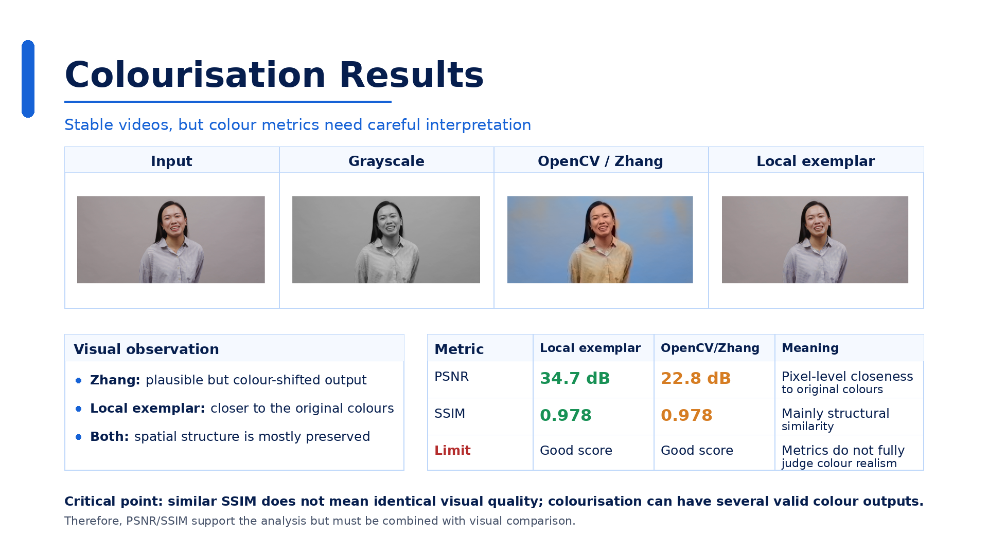
Notes:
The colourisation results were relatively coherent. In most cases, the objects, contours, and motion stayed almost unchanged. This makes sense because colourisation mainly changes colour information, not geometry. Quantitatively, the local exemplar method reached a higher average PSNR, around 34.7 dB, while the OpenCV Zhang model reached around 22.8 dB. However, both methods had a very similar SSIM, around 0.978. This is important to interpret carefully. SSIM mostly measures structural similarity, so it can stay high even if the colours are visibly different. Visually, Zhang sometimes produced strong colour shifts, while the local exemplar method was closer to the original colours. But the local exemplar method also depends strongly on the reference frame.

Slide 7
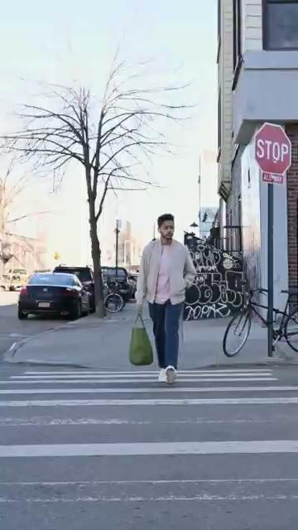
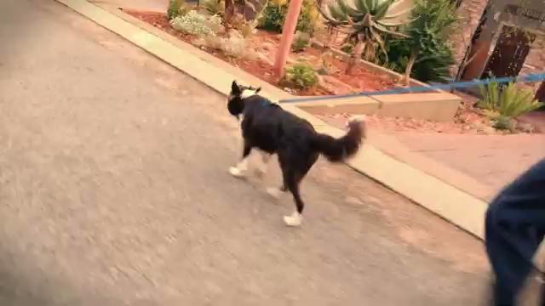
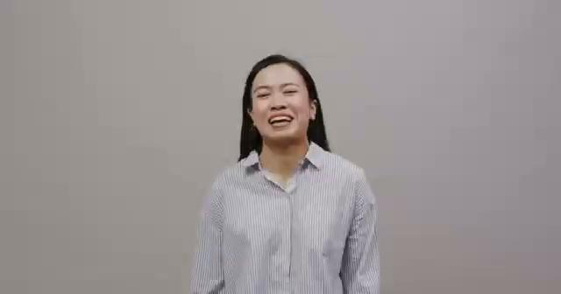
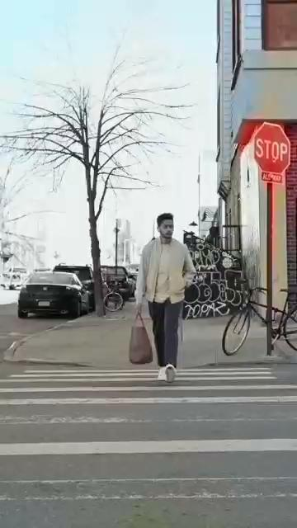
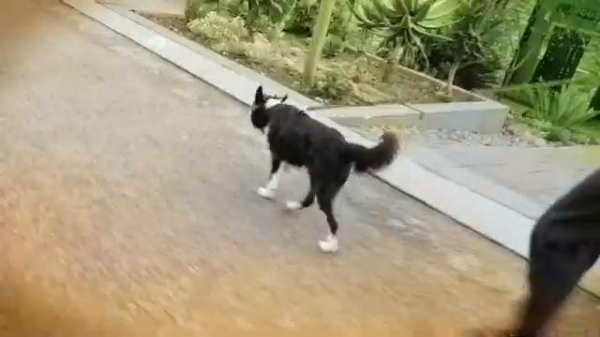
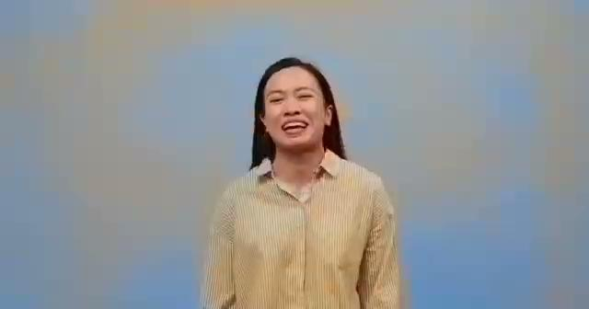
Local exemplar
Zhang colorisation

Slide 8
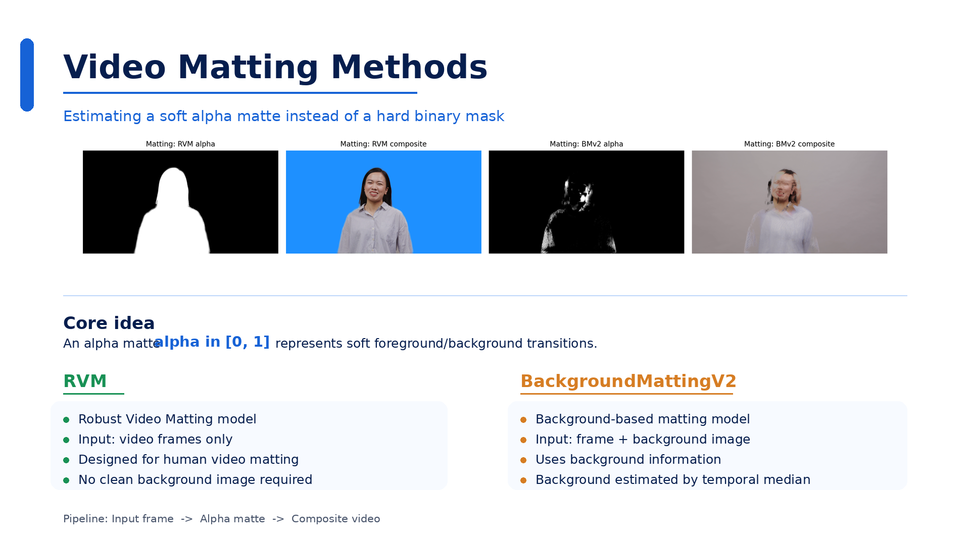
Notes:
For video matting, the goal was to estimate an alpha matte, not only a binary segmentation mask. This is important because real object boundaries are often soft. For example, around hair, clothes, motion blur, or thin structures, the foreground is not simply zero or one. We compared two methods. The first one was Robust Video Matting, or RVM. It is designed for human video matting and is expected to be more stable over time. The second method was BackgroundMattingV2. This method normally requires a clean background image. Since we did not have one, we estimated the background automatically using the temporal median of the video frames.

Slide 9

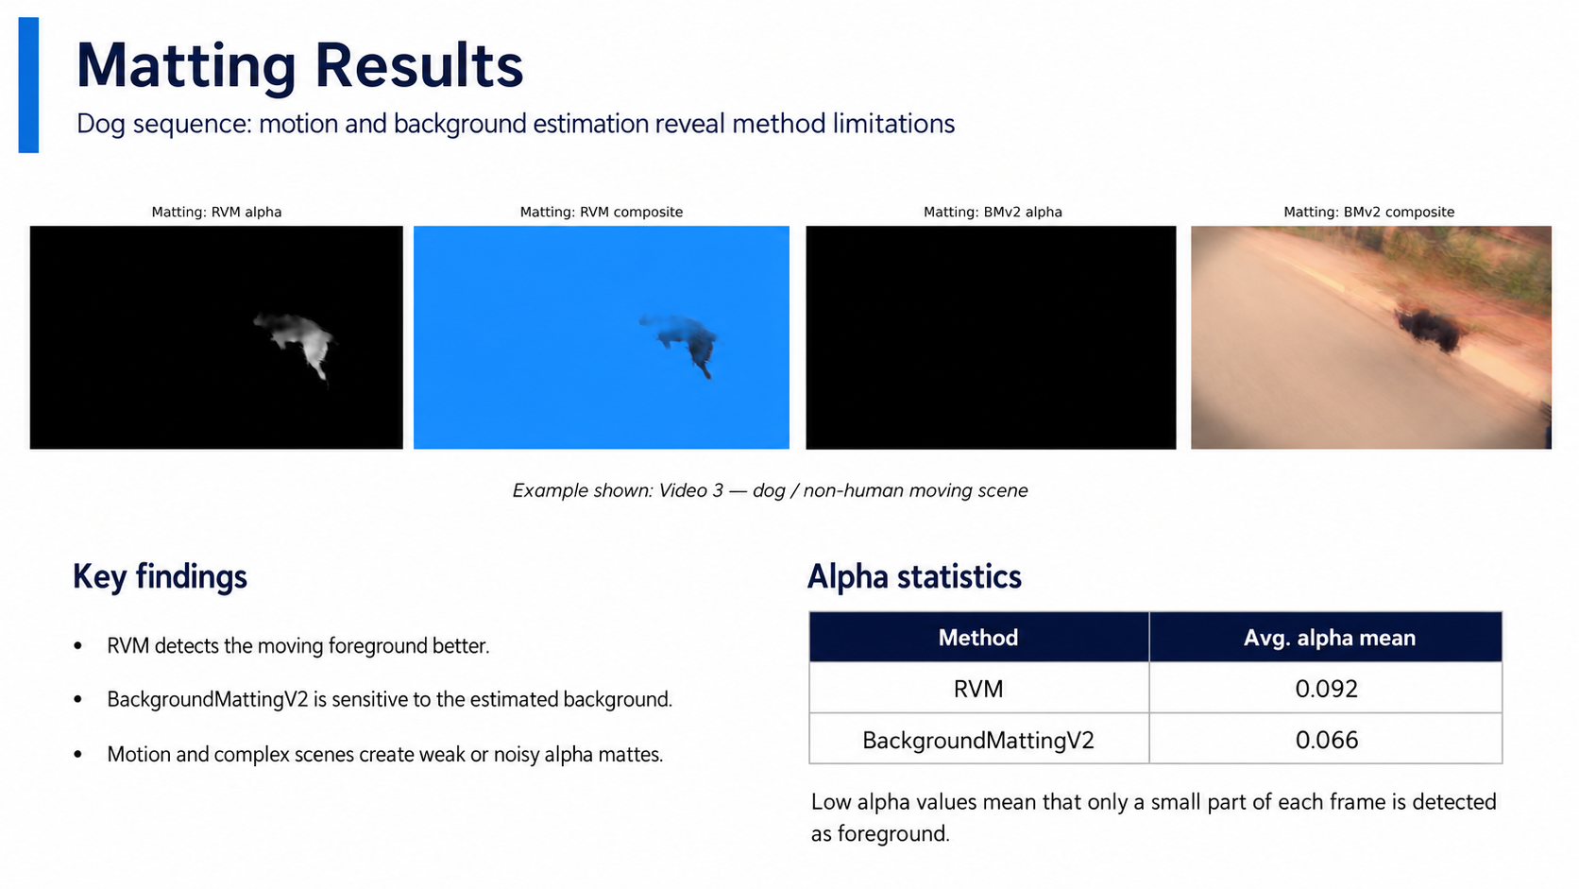
Notes:
The matting results showed clear differences between the methods. RVM was generally more adapted to human subjects, because it is made for video matting and does not require a clean background image. BackgroundMattingV2 was more sensitive to the quality of the background estimate. When the background was simple, the result could be acceptable. But when the scene was more complex, or when the foreground moved a lot, errors appeared around the subject. The alpha statistics were also useful. The average alpha values were low overall, which means that only a small part of each frame was detected as foreground. This helped us understand how much of the image was actually extracted.

Slide 10
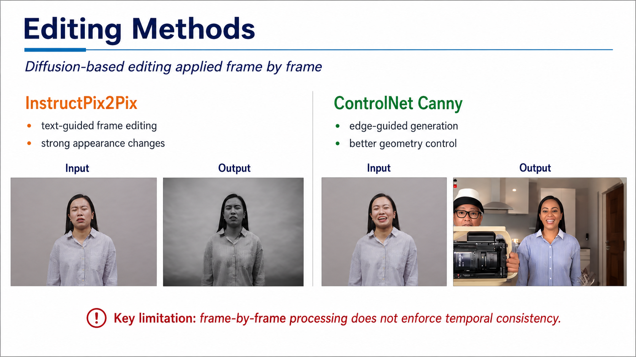
Notes:
For editing, we tested two diffusion-based approaches. The first one was InstructPix2Pix. It edits each frame using a text instruction. The second one was ControlNet Canny. In this method, Canny edges are extracted from the input frame and used as a structural condition for generation. In theory, ControlNet Canny should preserve geometry better because it receives edge information. However, both methods were still applied frame by frame. This is the key limitation of this part. The models do not know that the frames belong to the same video. They edit each image independently, without enforcing temporal consistency.

Slide 11
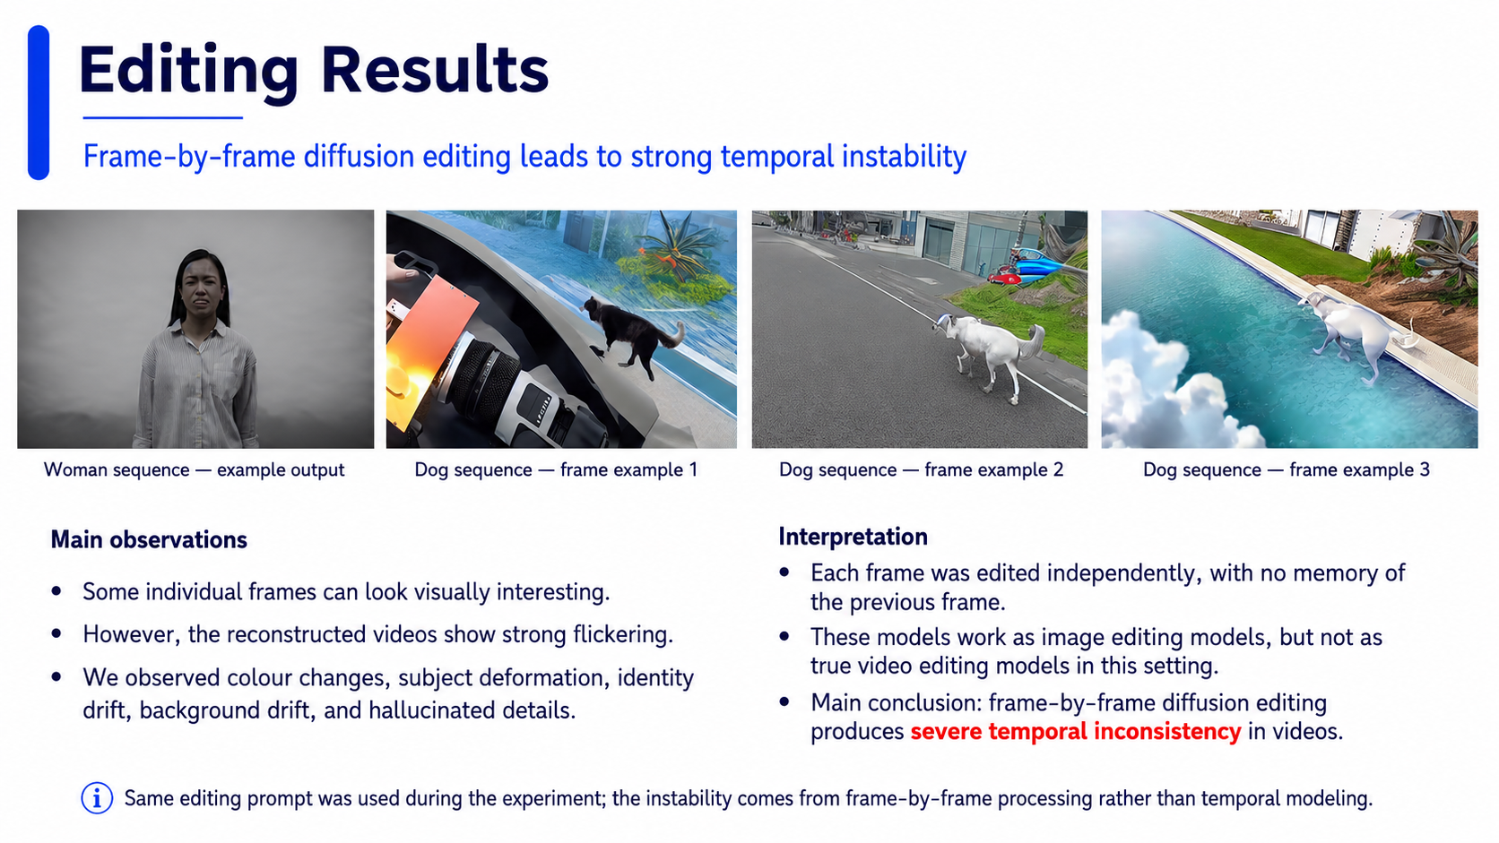
Notes:
The editing results were the least stable part of the project. We used the same editing prompt for both methods, so the differences mainly come from the model and its conditioning. Some individual frames could look visually interesting, but the reconstructed videos were not stable. We observed flickering, sudden colour changes, deformation of the subject, identity drift, background drift, and hallucinated details. This happened because each frame was edited independently, without memory of the previous frame. So these methods can be useful for image editing, but in our experiments they were not reliable as video editing methods. The main problem was not one bad frame, but the lack of coherence over time.

Slide 12
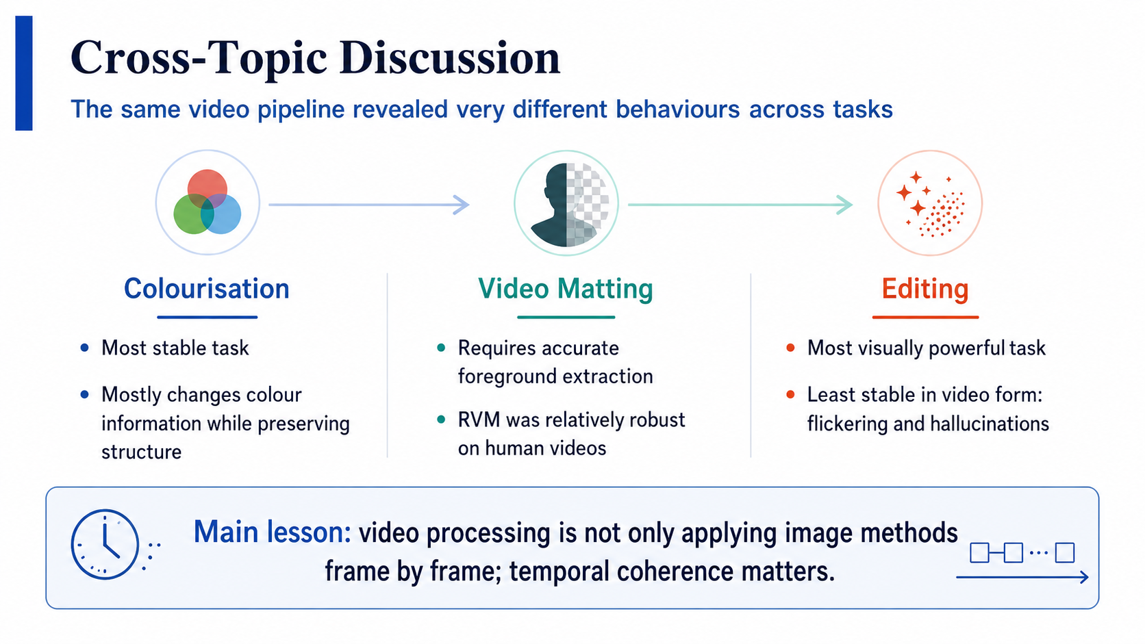


Notes:
Overall, the three topics behaved very differently. Colourisation was the most stable task, because it mostly preserved the image structure and only changed colour information. Matting was more difficult, because it required accurate foreground extraction and soft alpha boundaries. RVM was relatively robust on human videos, but the results were weaker on more difficult scenes. Editing was the most visually powerful task, but also the least stable in video form. Diffusion-based editing methods can create strong transformations, but they also introduce flickering and hallucinations. This comparison shows that video processing is not only about applying image methods frame by frame. Temporal coherence is essential.

Slide 13
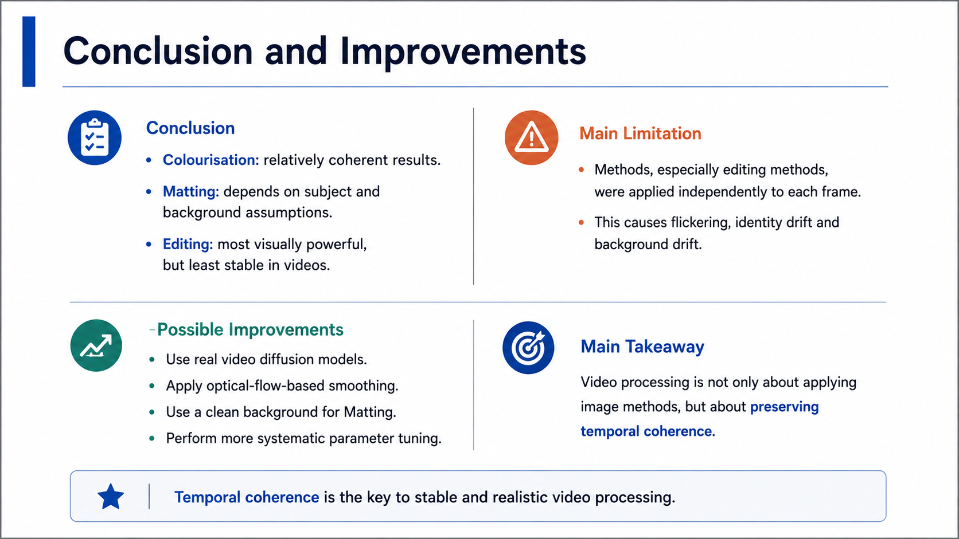
Notes:
To conclude, this project showed that the same videos can lead to very different behaviours depending on the task and the method. Colourisation gave relatively coherent results. Matting depended strongly on the subject and on the background assumptions. Editing revealed the strongest temporal consistency problems. The main limitation of our pipeline is that several methods, especially editing methods, were applied independently to each frame. For future improvements, we could use real video diffusion models, optical-flow-based temporal smoothing, a clean background image for BackgroundMattingV2, and more systematic parameter tuning. The main lesson is that stable video processing is not only about powerful image methods. It is also about preserving coherence across time.

